Slide 1


Comprehensive Marketing Analysis of Walmart:
" A Data-Centric Approach to Walmart's Product and Pricing Strategies "
PRESENTATION

Slide 2



Agenda:
01
Overview
02
Data Preprocessing
03
Exploratory Data Analysis (EDA)
04
Advanced Analysis
05
Recommendations

Slide 3




ABOUT
Walmart is an American multinational retail corporation that operates a chain of hypermarkets, discount department stores, and grocery stores.
It's known for its commitment to everyday low prices and a wide range of products.
Services:
Offers a wide range of products: From groceries to electronics, clothing, and home goods.
E-commerce: Walmart has a strong online presence, offering online shopping and delivery services.

Slide 4


WELCOME TO PRESENTATION
By: Nilesh Kokulwar

Slide 5



Project Overview
LOGO
Objective: To analyze Walmart's dataset and extract actionable insights for better marketing strategies.
Key Tasks:
Data Cleaning and Preprocessing
Exploratory Data Analysis (EDA)
Advanced Analysis (e.g., Churn Analysis, Product Lifetime Value etc.)
SWOT Analysis and Recommendations

Slide 6

Dataset Overview
LOGO
Shape of Dataset: (25340, 34) (No. of Rows, No. of Columns)
Key Columns:
Category,
Sub_category,
Brand name,
current_price,
discount,
Rating,
Review
Unit_price etc.
Data Source: Live-scraped from Walmart website.

Slide 7

Data Preprocessing
Handling Missing Values: Imputed missing Rating and Review data to ensure robust analysis.
Feature Engineering:
i. Created discount_percentage to quantify the impact of discounts on sales.
ii. Added revenue_per_unit to measure product profitability.
iii. Introduced time_on_market to account for product lifecycle.
Converted columns like datetime into usable formats.
Created a new 'price_category' feature to categorize ‘low-cost’, ‘mid-range’ and ‘premium’ products.
A clean and enriched dataset ready for exploratory and advanced analyses.
Source of Data: Live-scraped from Walmart website.

Slide 8
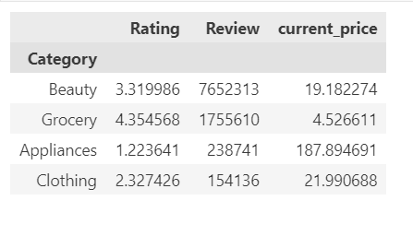

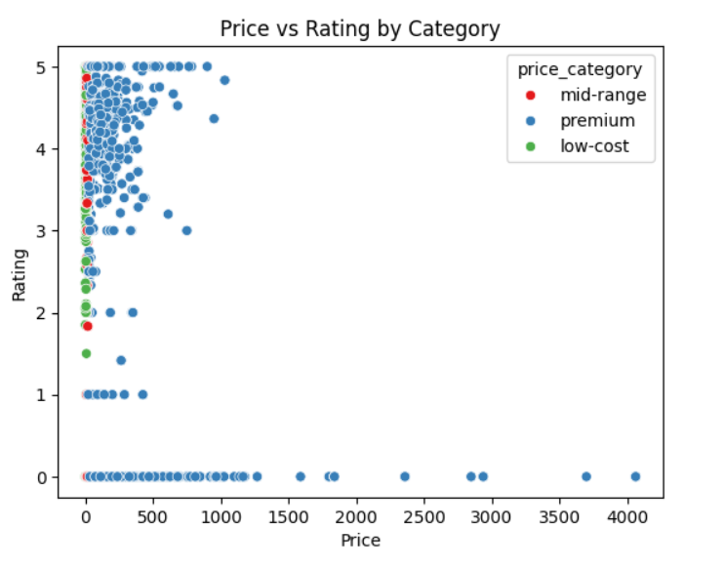

Exploratory Data Analysis (EDA)
Product Performance Analysis:
Top Performing Categories:
Comparison of Price and Rating by Price_Category

Slide 9
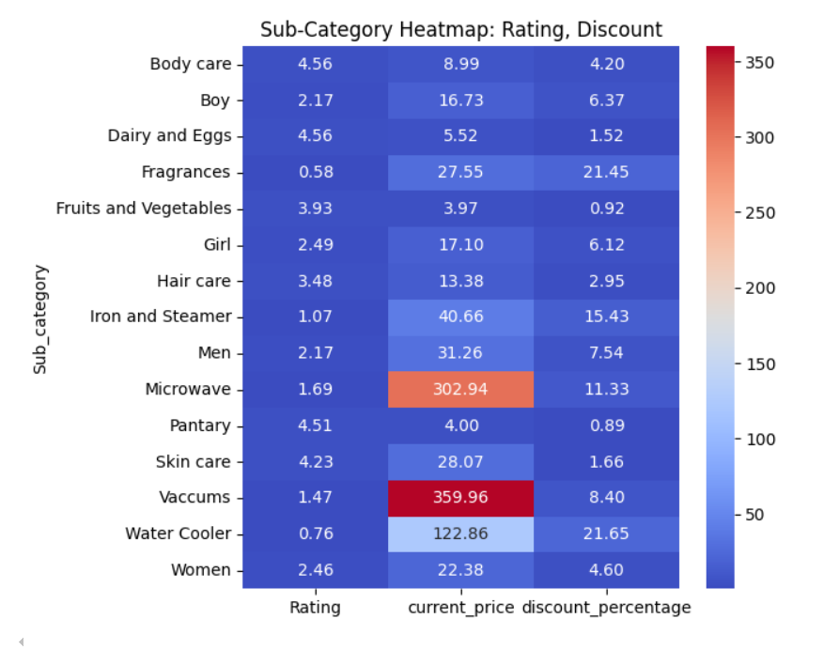






Exploratory Data Analysis (EDA) (cont.)
Pricing, Rating & Discount Analysis:
Key Observations:
Rating:
Sub-categories like Body care, Dairy and Eggs, and Skin care have relatively high average ratings.
Discount Percentage:
Sub-categories like Microwave, Vacuums, and Water Cooler have significantly higher average discount percentages, suggesting potential clearance sales or promotional offers.
Current Price:
Sub-categories like Microwave, Vacuums, and Water Cooler have higher average current prices, which might be due to their higher-end nature or the impact of discounts on the average price.

Slide 10
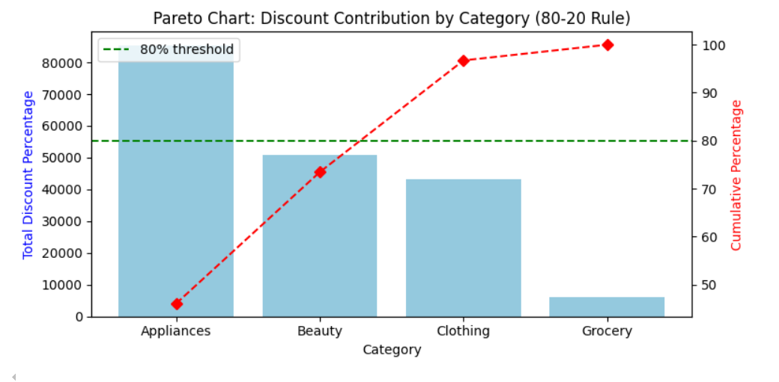
Advanced Exploratory Data Analysis
Pareto Analysis (80/20 Rule):
The Pareto chart illustrates the "80-20 rule" in action, showing which categories contribute most of the total discount percentage, showing promotional effort.
Key Observations:
The green dashed line indicates the 80% threshold. The category "Appliances" surpasses this threshold, highlighting its significance.
Insights:
Since Appliances drive most discounts, it may be worth exploring strategies to optimize discounts in this category. This could involve analyzing customer behavior, competitor pricing, and promotional effectiveness

Slide 11
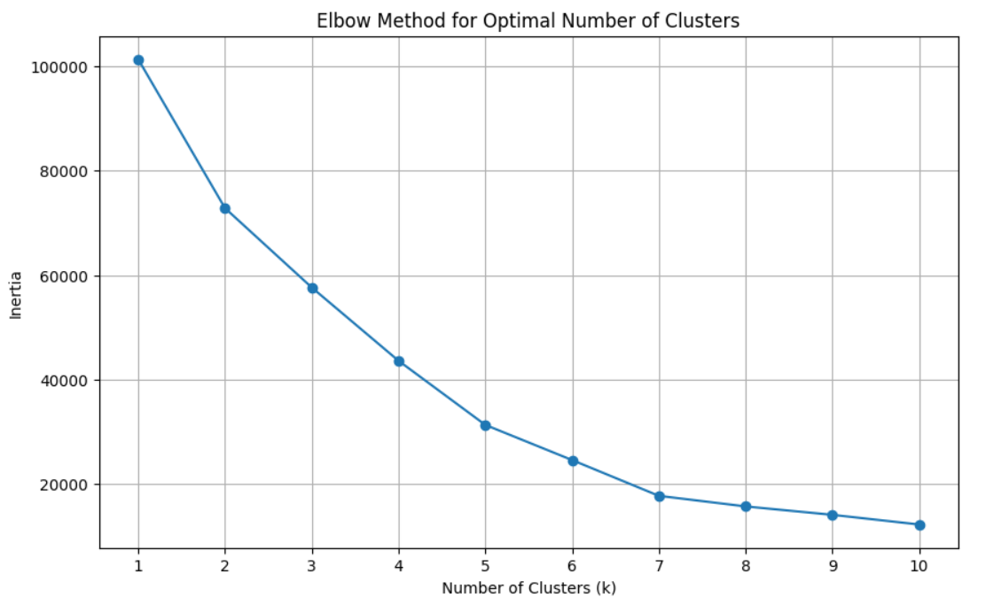
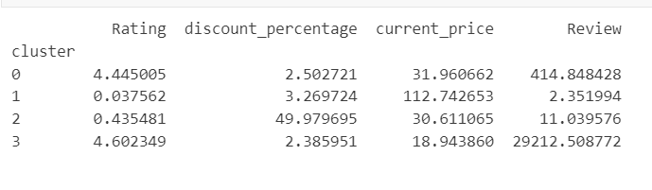


Advanced Machine Learning Analysis
Product Segmentation:
Using K-Means Clustering:
The Elbow Method is a technique used to determine the optimal number of clusters by observing the "elbow point" in the plot.
In this specific plot, the elbow point appears to be around k=4.
Based on the mean values for each feature within each cluster, we can say the following:
Cluster 0: This cluster represents products with relatively high ratings, moderate discounts, and a significant number of reviews. These are popular products with good customer feedback.
Cluster 1: This cluster contains products with extremely low ratings, moderate discounts, and very few reviews. These are the products that have received negative feedback or have not been widely reviewed.

Slide 12
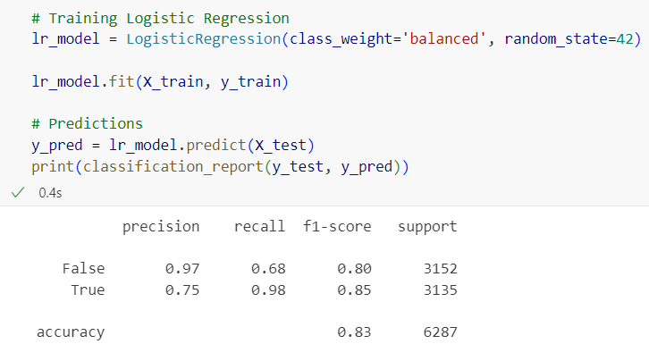
Advanced Machine Learning Analysis
Product Churn Analysis :
Created a Churn Indicator feature to flag products with low ratings or can be frequently returned.
Logistic regression with balanced class weights has been implemented for classification.
SMOTE (Synthetic Minority Oversampling Technique) is used to address class imbalance, improving model performance.
Model Performance:
Overall Accuracy: The model achieved an overall accuracy of 83%, which indicates a reasonably good performance.
Key Insights:
Identify the products that the model classifies as high-risk (i.e., predicted to churn).
Prioritize these products for further analysis and potential interventions, such as:
Offering discounts or promotions
Improving product quality or features
Enhancing customer support

Slide 13
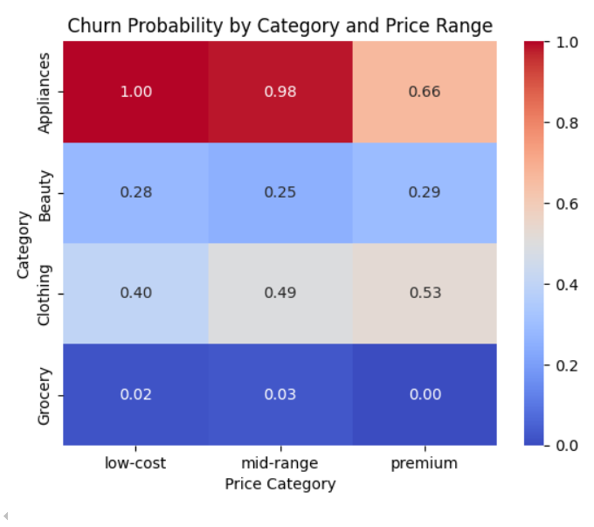
Advanced Machine Learning Analysis
The heatmap "Churn Probability by Category and Price Range" provides a visual representation of the likelihood of churn for different product categories and price ranges.
Churn probability is highest for Appliances and lowest for Grocery products.
Within each category, there is a general trend of decreasing churn probability from low-cost to premium products.

Slide 14
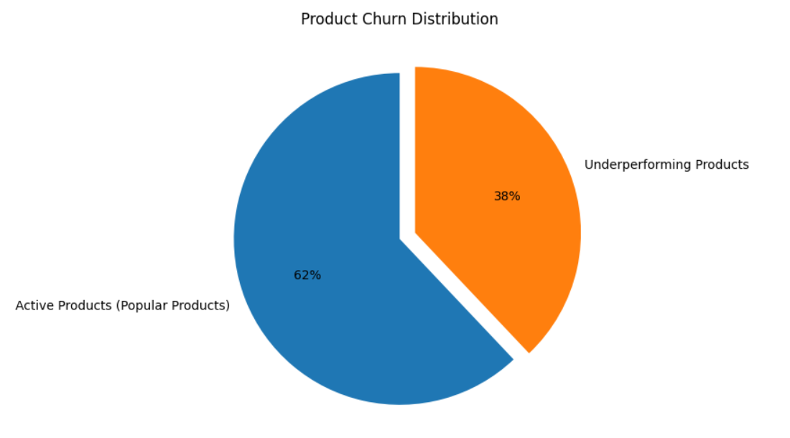
Advanced Machine Learning Analysis
Insights:
Active Products (Popular Products): 62% of the products are considered active or popular. This indicates that a significant portion of the product portfolio is performing well.
Underperforming Products: 38% of the products are classified as underperforming. This suggests that there is room for improvement in certain areas of the product portfolio.
Actions:
Identify Underperforming Products: Analyze the characteristics of underperforming products, such as their features, pricing, and marketing strategies.

Slide 15
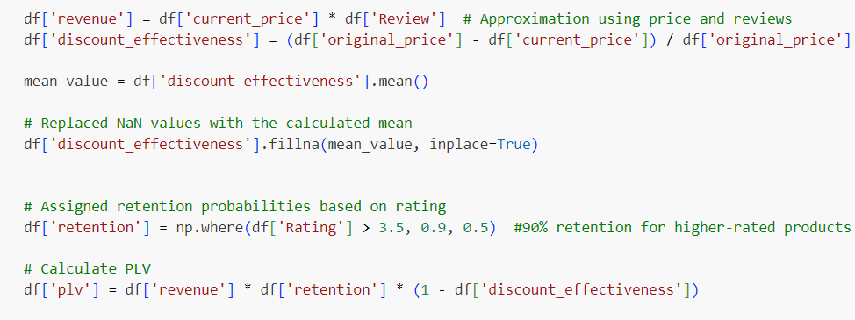
Advanced Machine Learning Analysis
Product Lifetime Value (PLV)
Product Lifetime Value (PLTV) is a metric that measures the total revenue a company can expect to generate from a single product over its entire lifecycle.
Revenue is an estimated revenue based on the product's current price and the number of reviews.
Discount Effectiveness measures the impact of discounts on the product's revenue.
Retention represents the likelihood of a customer returning to purchase the product again. It's assigned based on the product's rating. Higher-rated products are assumed to have a higher retention rate.

Slide 16
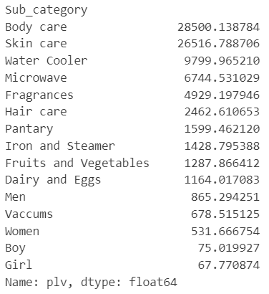

Advanced Machine Learning Analysis
Interpretation of PLV:
A higher PLV indicates a product with:
Strong Customer Appeal: High revenue and retention suggest that the product is popular, and customers are likely to repurchase.
Effective Pricing Strategy: A lower discount effectiveness implies that the product is priced optimally, maximizing revenue.
With a PLV of 28500, Body Care is the top-performing subcategory. This suggests that products in this category are highly engaged and have a lifecycle.
Use Cases of PLV:
Product Prioritization: Identify high-potential products for investment and marketing.
Inventory Management: Optimize inventory levels based on product value.

Slide 17




S
W
STRENGTHS
WEAKNESSES
High-performing categories and products.
Low-rated or frequently returned products.
SWOT ANALYSIS
OPPORTUNITIES
THREATS
Untapped potential in categories with high discounts but low reviews.
Stockouts, competitor strategies, or negative customer feedback.
O
T

Slide 18
Recommendations:
Product Strategy:
Focus on high-performing categories and products.
Improve underperforming products or discontinue them.
Pricing Strategy:
Optimize pricing strategies based on product category and customer segment.
Consider dynamic pricing to maximize revenue.
Inventory Management:
Utilize stock prediction models to optimize inventory levels.
Implement effective demand forecasting techniques.

Slide 19

RESOURCE PAGE :
Group Labs
https://www.walmart.ca/en
https://en.wikipedia.org/wiki/Walmart
ChatGPT and Gemini
https://www.slidescarnival.com/

Slide 20
Thank You!

